Slide 1
How Blockchains Are Changing The World
Loi Luu
https://comp.nus.edu.sg/~loiluu
loiluu@comp.nus.edu.sg

Slide 2
About me
PhD candidate at NUS
Research interests
Blockchains, cryptocurrencies
Consensus Protocols
Publish in major security conferences
CCS’15, CSF’15, CCS’16
Talks
ScalingBitcoin 2015
Ethereum Devcon 2

Slide 3
Some ugly facts

Slide 4
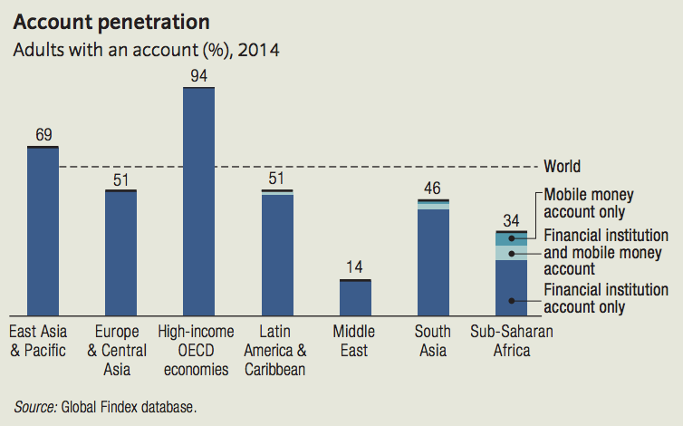
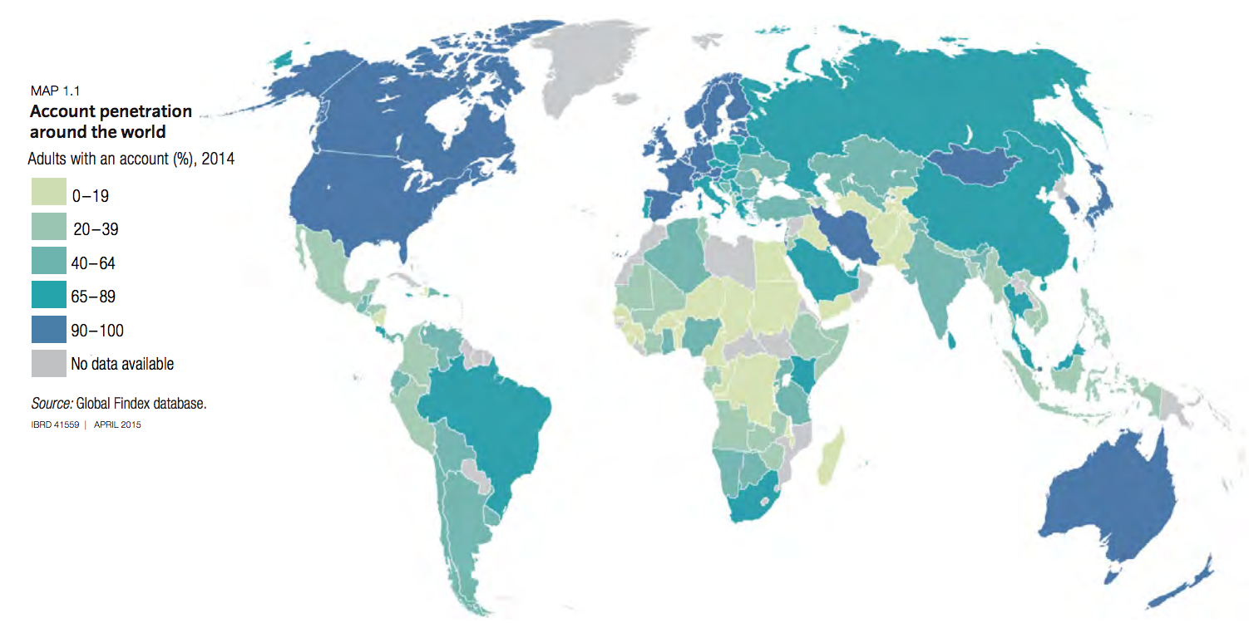
40% adults are unbanked

Slide 5

Yet among them, 50% have mobile phone

Slide 6
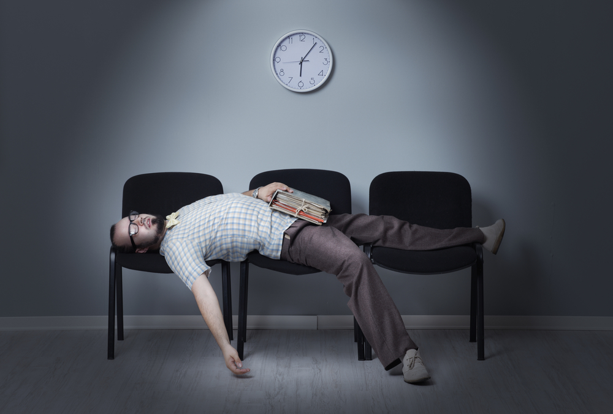
Bank transfers take days

Slide 7
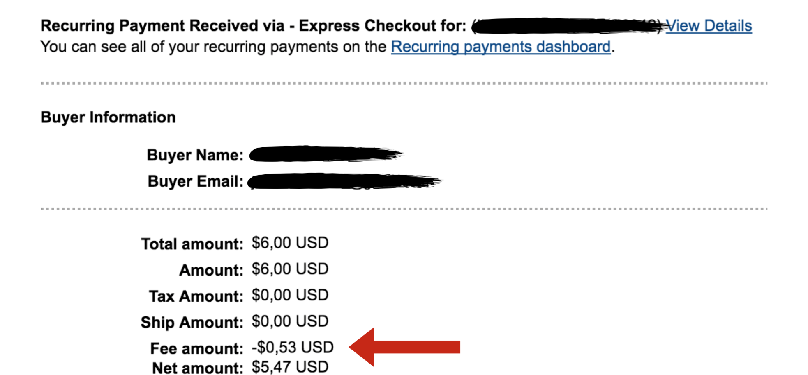
Yet the transfer fee is absurdly high

Slide 8
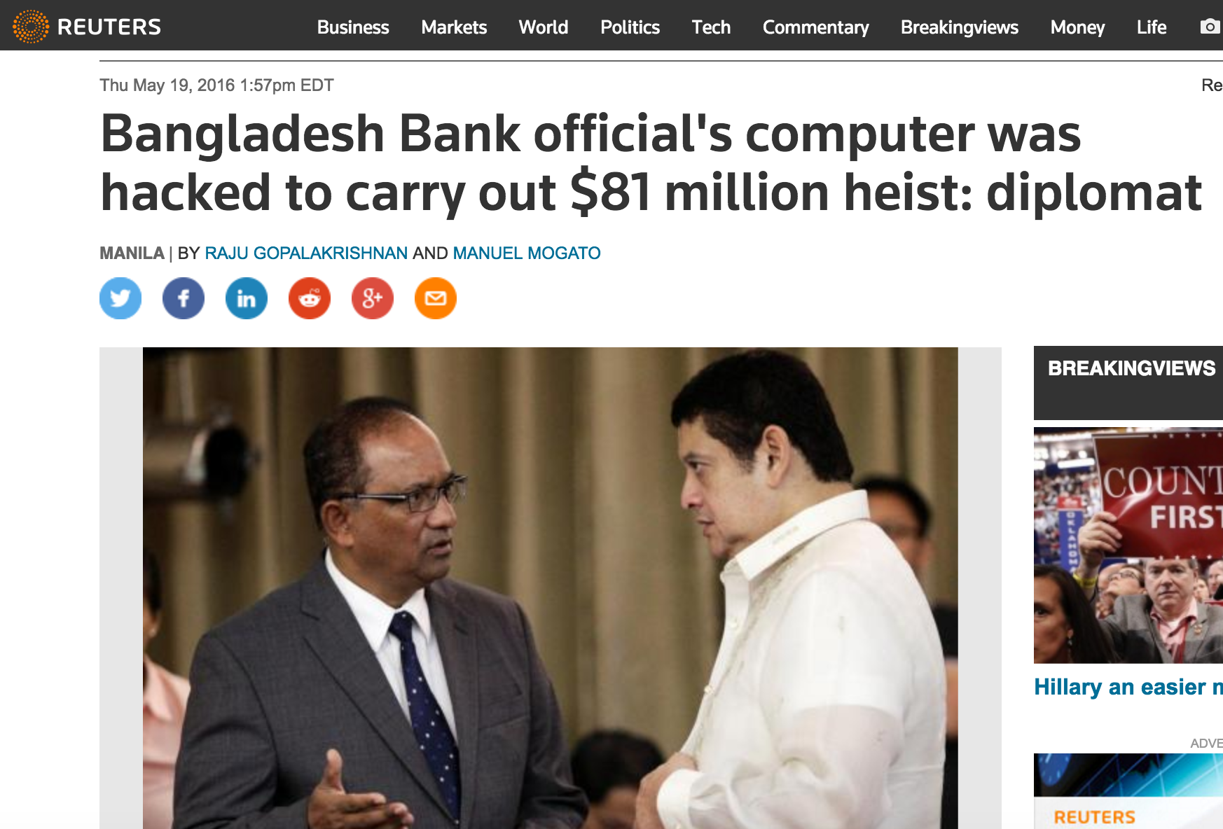
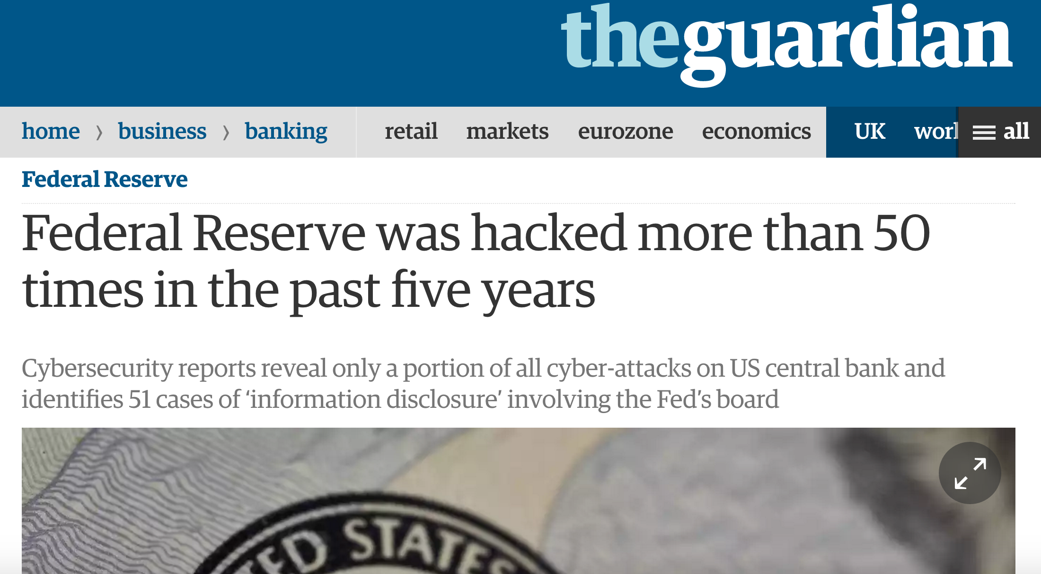
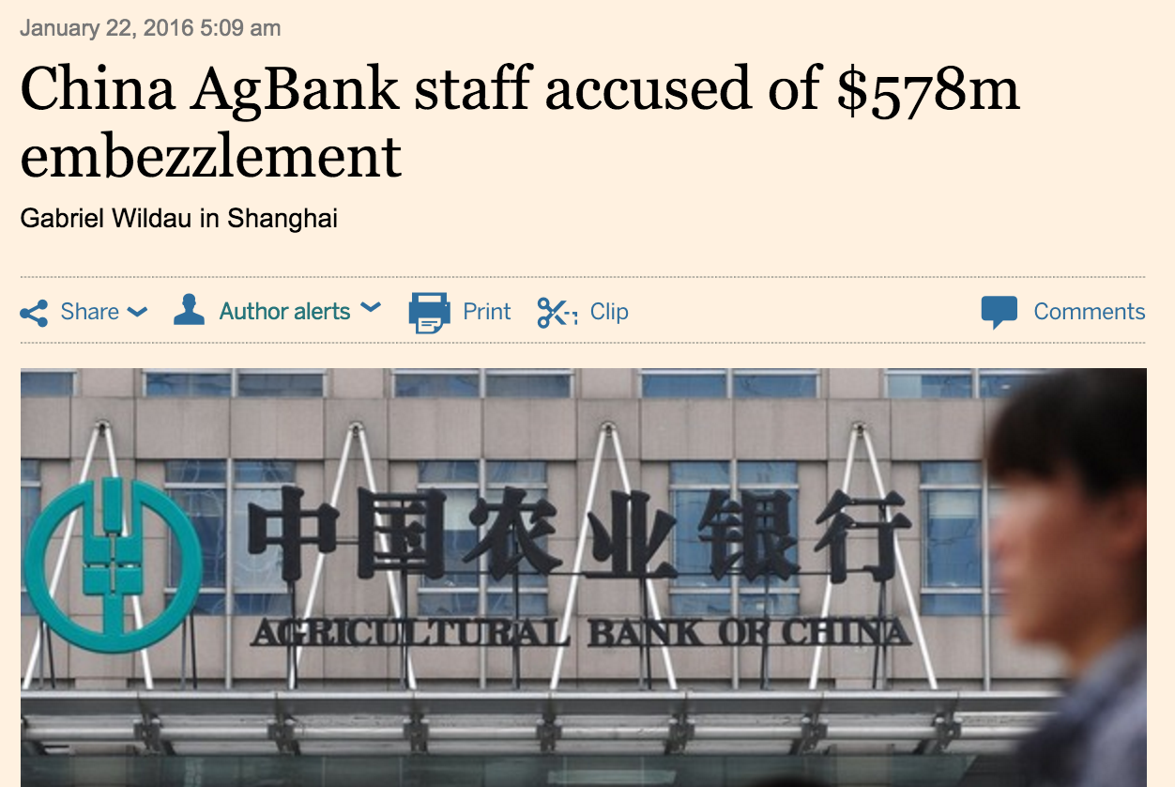
Banks keep getting hacked

Slide 9


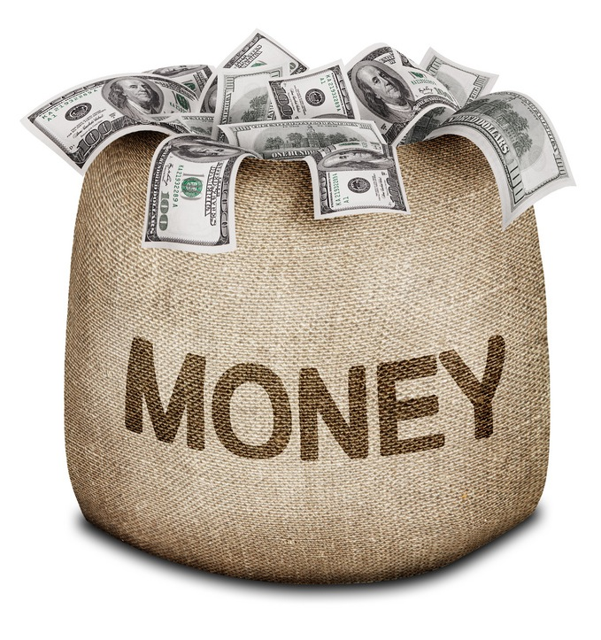

Google sells our information for ads
And take a big cut from the publishers
32% revenue share for content
49% revenue share for search

Slide 10
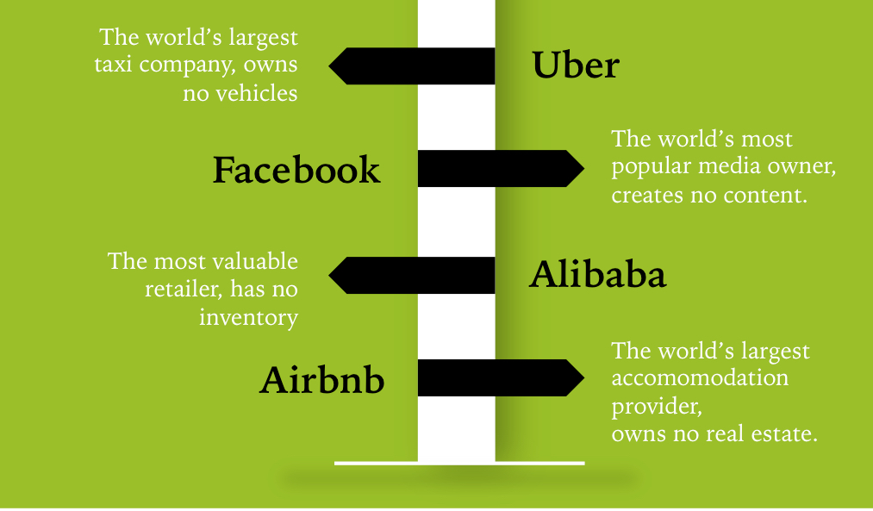
A lot more
They take a big piece of the cake, just to be a middle man

Slide 11
Why haven’t we done that?
Is our technology insufficient?

Slide 12
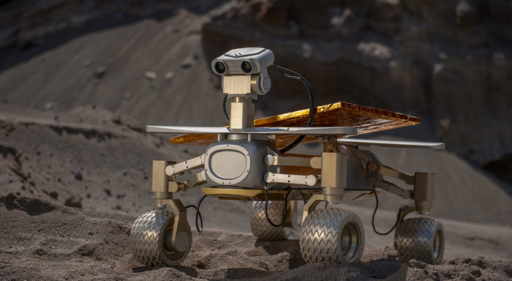
I don’t think so

Slide 13
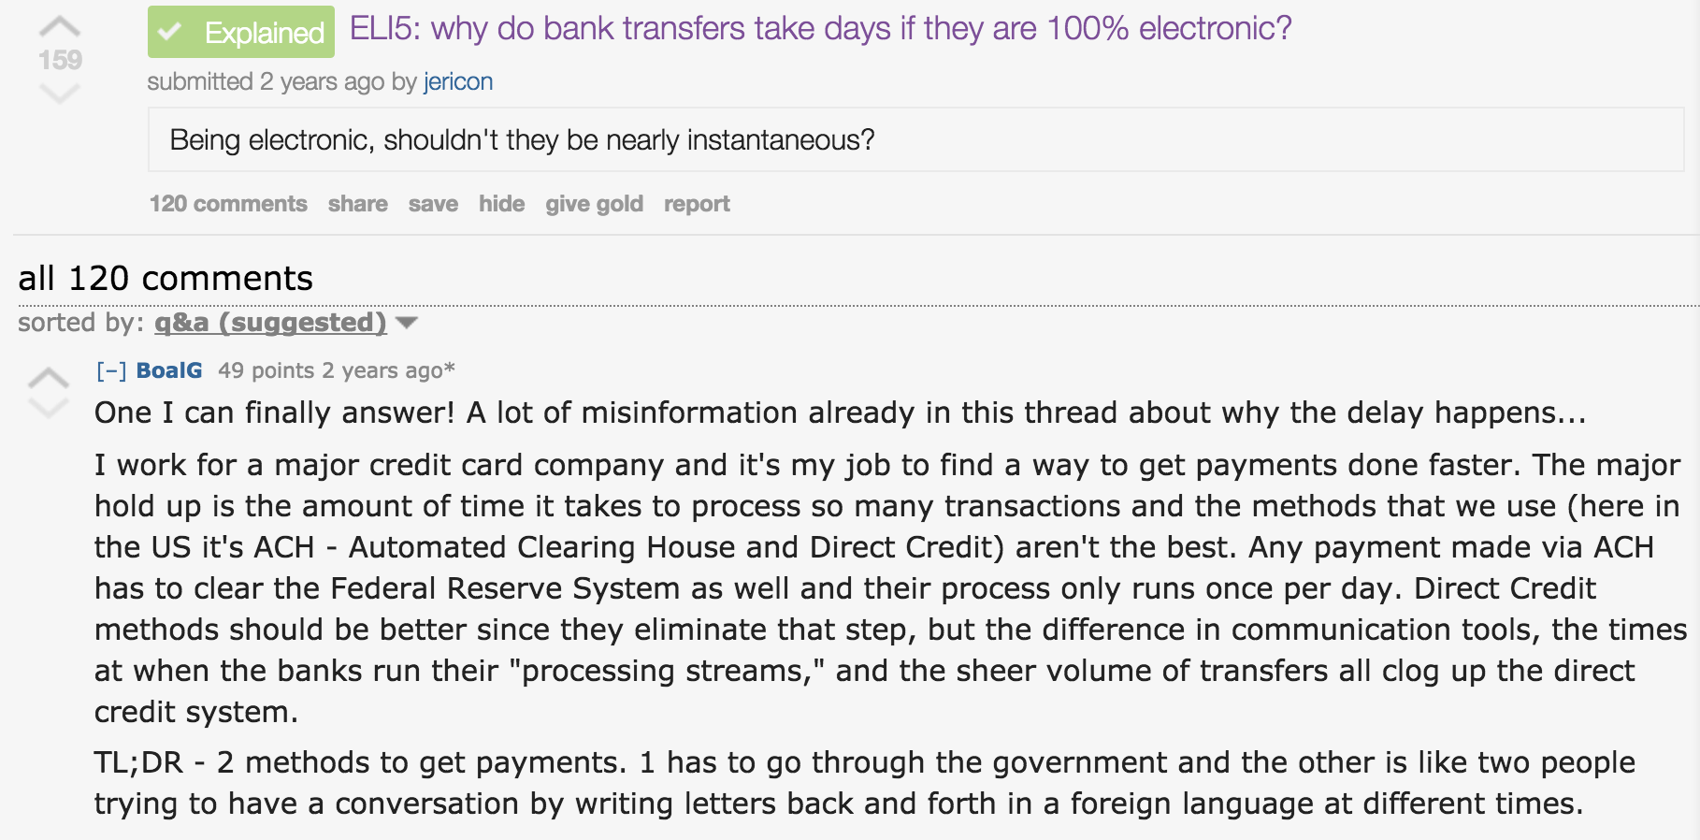
Why bank transfers take DAYs?

Slide 14
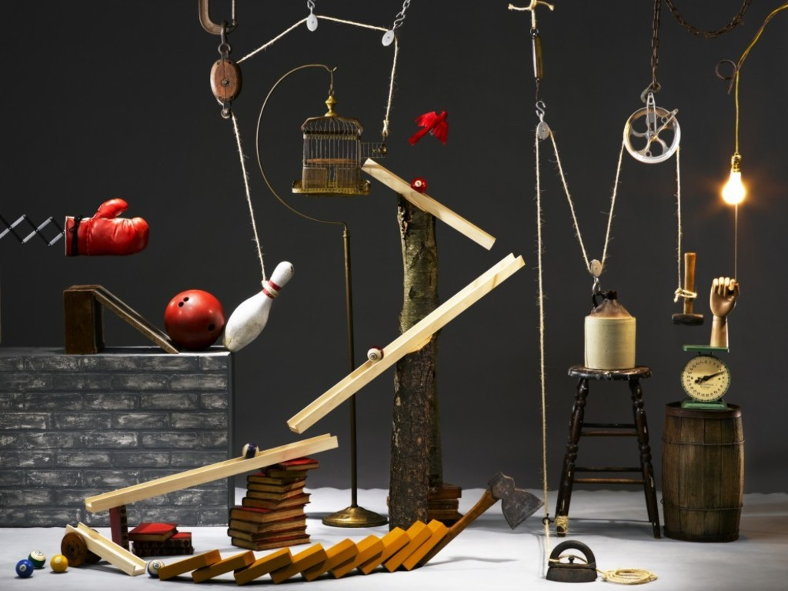
Why bank transfers take DAYs?
We have more than one middle man
Notes:
Its called Rube Goldberd machine

Slide 15
Solution: Blockchains

Slide 16
Blockchain 101

Slide 17
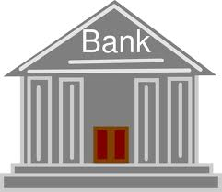
Distributing Trust & Enforcing Neutrality
Centralized Operator
De-Centralized Operators
Problems:
Single point of Failure
Mutability / Forgery of Records
P1
P1
P6
P2
P6
P2
P5
P3
P5
P3
P4
P4

Slide 18





Blockchain: A Decentralized Ledger
Decentralized Operators
Immutability
P1
P6
P2
Verifiability
Access Controlled
P5
P3
P4
Resilience

Slide 19
A ledger contains multiple blocks
TX-1: Alice -> Bob
TX-2: Bob -> Mary
…..
TX-1: Alice -> Bob
TX-2: Bob -> Mary
…..
TX-1: Alice -> Bob
TX-2: Bob -> Mary
…..
Each block has multiple transactions
A transaction transfers some asset from sender to receiver
Assets can be anything from cryptocurrency, contract, access key,..
…….

Slide 20
How to Agree on The Ledger State?
P1
Consensus Protocols:
Operators “agree” on the blockchain state.
Periodically select valid transactions to append to the ledger
P6
P2
TX-1: Bob -> Mary
TX-2: Alice -> Mary
TX-1: Alice -> Bob
TX-2: Alice -> Mary
P5
P3
P4
TX-1: Alice -> Bob
TX-2: Bob -> Mary

Slide 21
How to Agree on The Ledger State?
P1
TX-1: Alice -> Bob
TX-2: Bob -> Mary
Consensus Protocols:
Operators “agree” on the blockchain state.
Periodically select valid transactions to append to the ledger
TX-1: Alice -> Bob
TX-2: Bob -> Mary
P6
P2
TX-1: Alice -> Bob
TX-2: Bob -> Mary
TX-1: Alice -> Bob
TX-2: Bob -> Mary
P5
P3
P4
TX-1: Alice -> Bob
TX-2: Bob -> Mary

Slide 22


Consensus Protocols: Nakamoto Consensus (Bitcoin’s)
P1
Consensus Protocols:
Nodes “agree” on the blockchain state.
Select valid transactions to append to the ledger
P6
P2
P5
P3
I’m a leader
P4
TX-1: Alice -> Bob
TX-2: Bob -> Mary

Slide 23
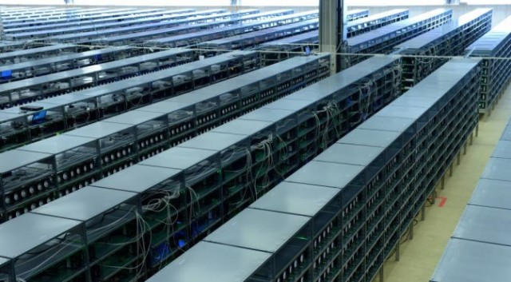
High security guarantee
It requires the computation power of 100 Googles to compromise the Bitcoin blockchain

Slide 24
How blockchains can change the world?
Or what can we do with blockchains?

Slide 25
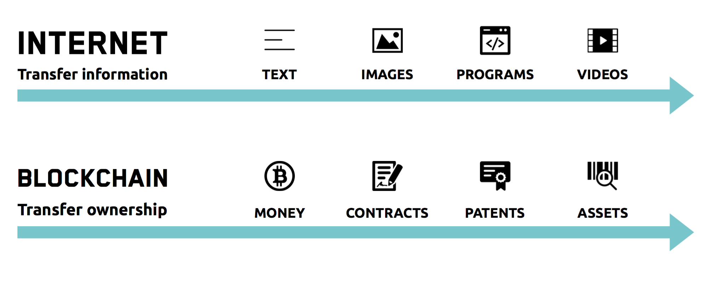
Blockchains remove the middle man
Just like what internet does to information

Slide 26




Banking without banks
Fast
Instant confirmation, at most an hour
Low fee
5 cents for transaction of any size
Easy to access
Can run on mobile phone

Slide 27
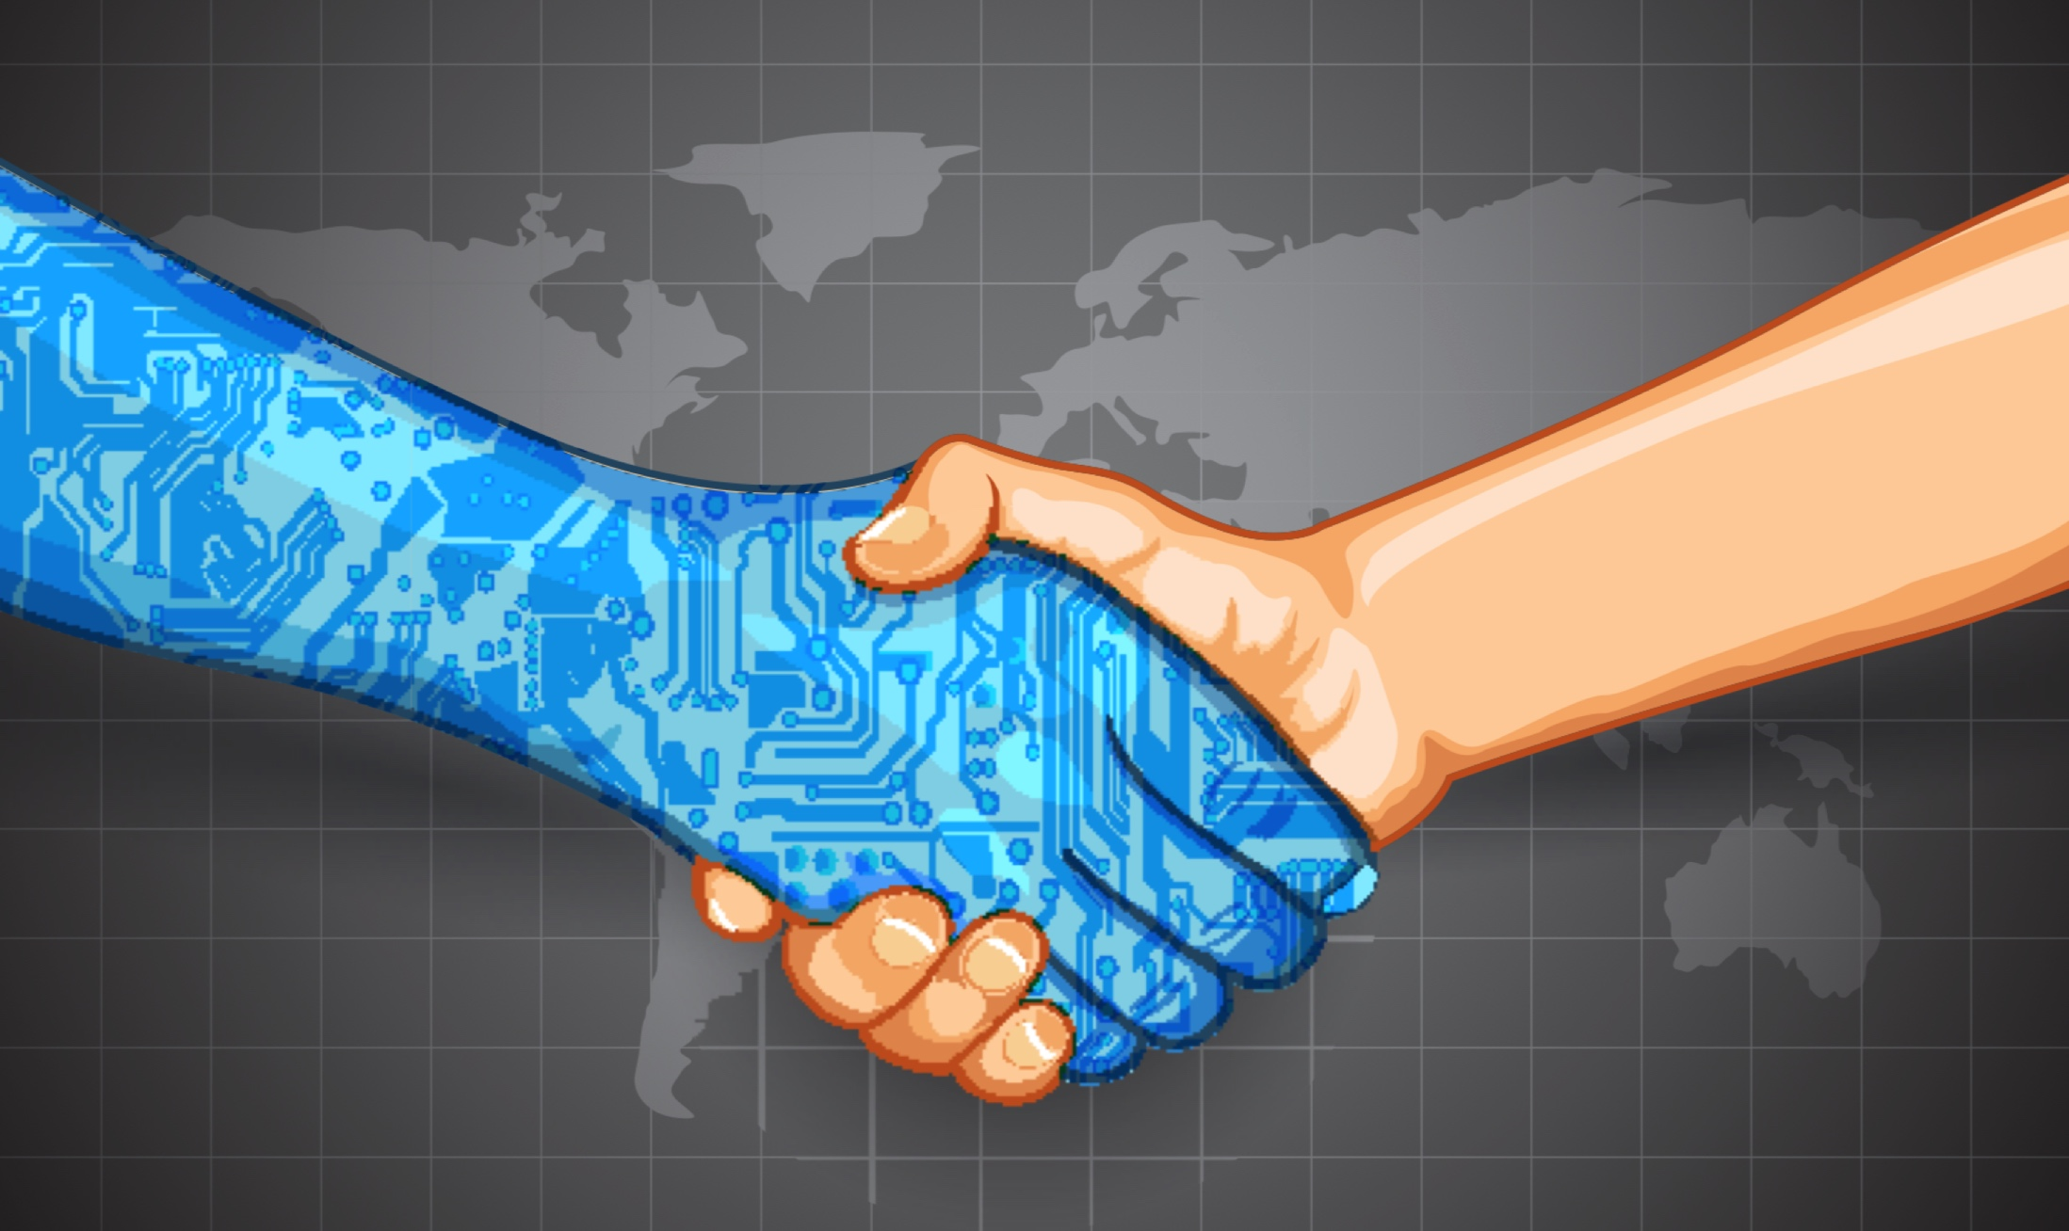
Employments without physical contracts
People can work directly together
Using smart contracts
Get paid in cryptocurrency

Slide 28
X without X
Uber… without Uber
Facebook without Facebook
Alibaba Without Alibaba
AirBnb Without AirBnb

Slide 29
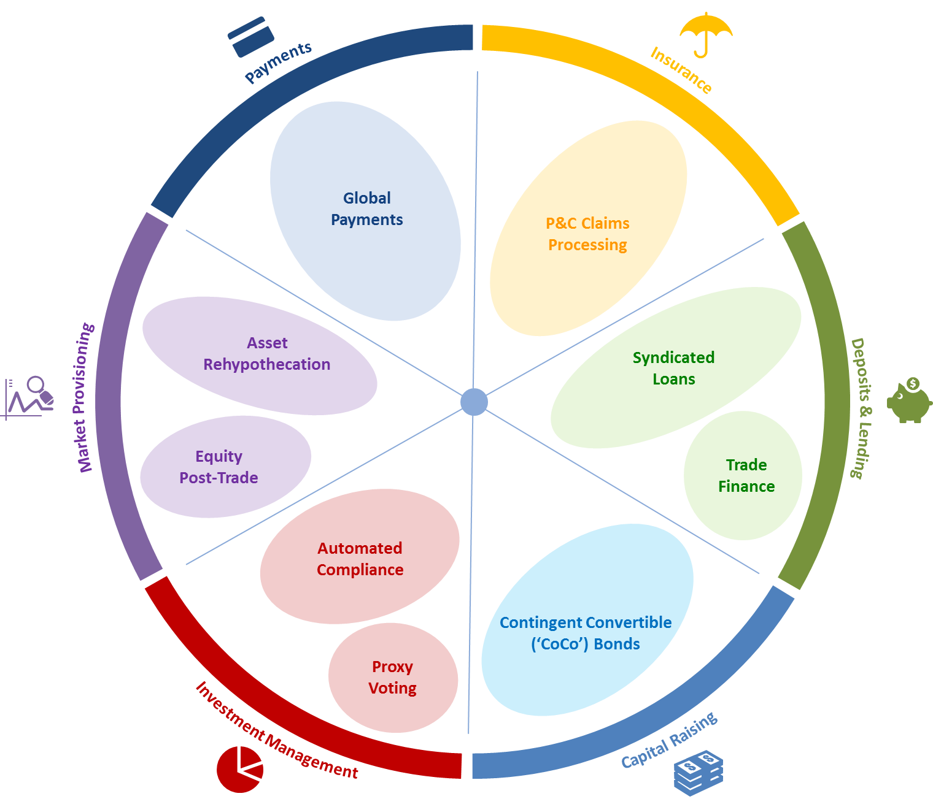
“Blockchains will Become Beating Heart of the Global Financial System”
WEForum

Slide 30
Blockchain is just like the internet
The Internet in the 90s
People don't get it
It looks ugly
We have few use cases
People don’t see how it will change the world
Those who are disrupted by it
will do everything to stop it.
Mainstream 10 years later
Mass adoption 20 years later

Slide 31
Thank you
https://comp.nus.edu.sg/~loiluu

